Slide 1
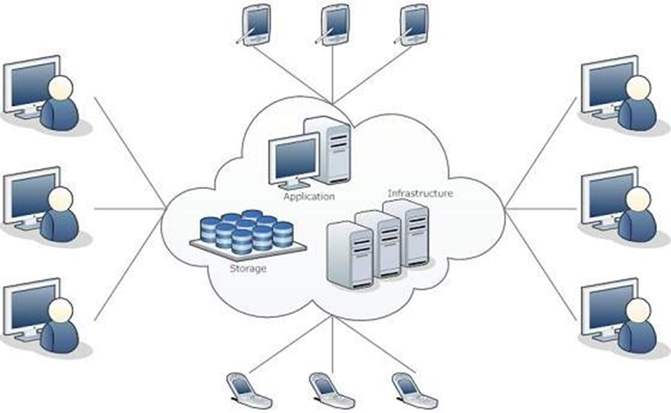
History & Evolution to Cloud Computing (from Desktop to Data Center)
By: Dr. Rajeshwari Trivedi

Slide 2
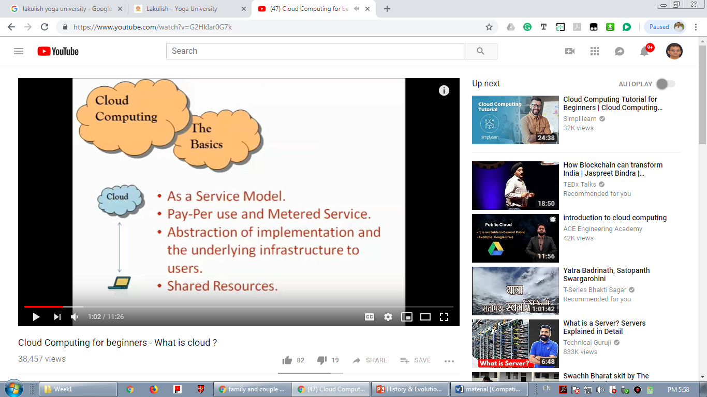
Cloud
Cloud is a mass of droplets in the sky and it is attracted with the Gravity and comes to earth in the form of Rain…
Same in IT field cloud is mass of Infrastructure, Applications, Services which are floated in the datacenters (instead of sky) and attracted by money.
Money may be paid by users, organizations or the clients for renting or hiring these services.

Slide 3
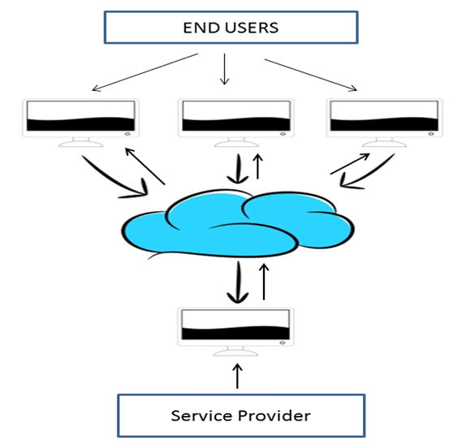
Cloud
The term Cloud refers to a Network or Internet.
Mainly it has been used in the telecommunication as an abstraction of the network in system diagrams.
In other words, we can say that Cloud is something, which is present at remote location. Cloud can provide services over public and private networks, i.e., WAN, LAN or VPN.
Applications such as e-mail, web conferencing, customer relationship management (CRM) execute on cloud.
Network engineers to represent the location of various network devices and there inter-connection. The shape of this network design was like a cloud.

Slide 4
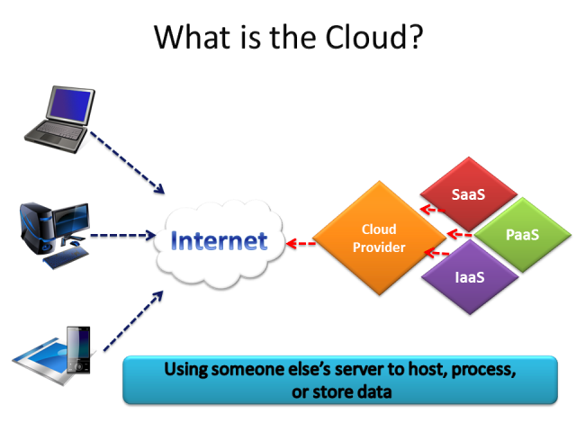

Slide 5
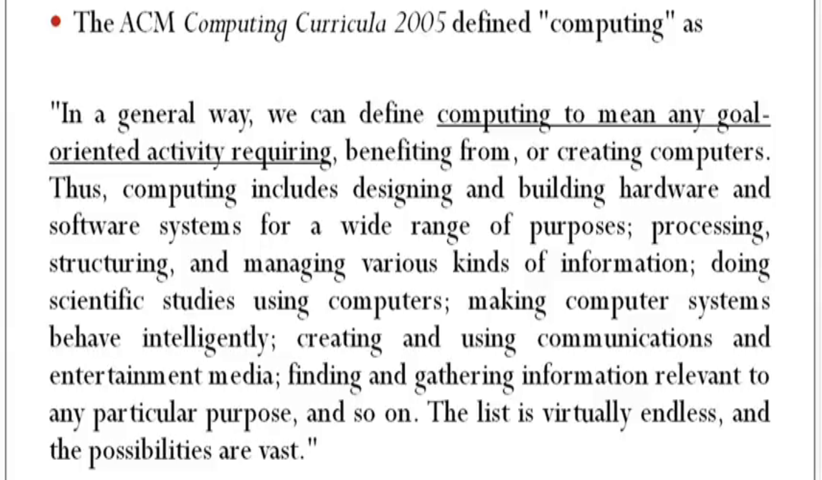
Computing
To compute/ the use or operation of computers.
Computing is the process of using computer technology to complete a given goal-oriented task.

Slide 6

Cloud Computing
Cloud computing means a type of Internet-based computing, where different services —including servers, storage and applications — are delivered to an organization's computers and devices through the Internet.

Slide 7
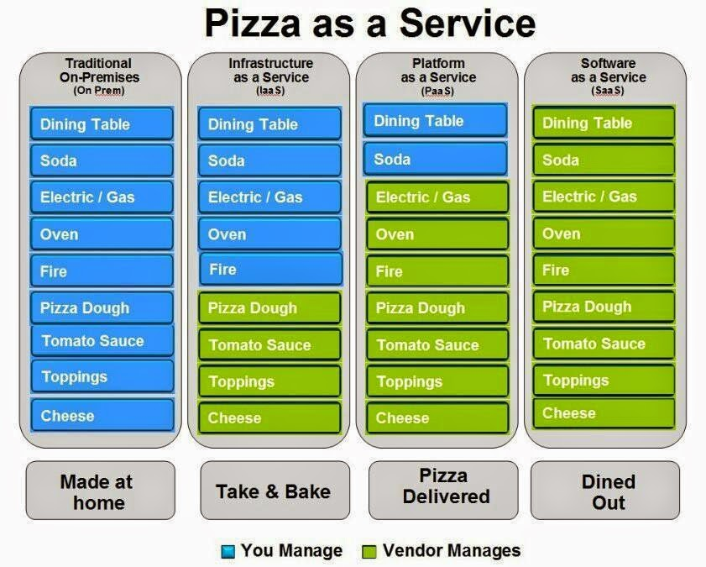

Slide 8
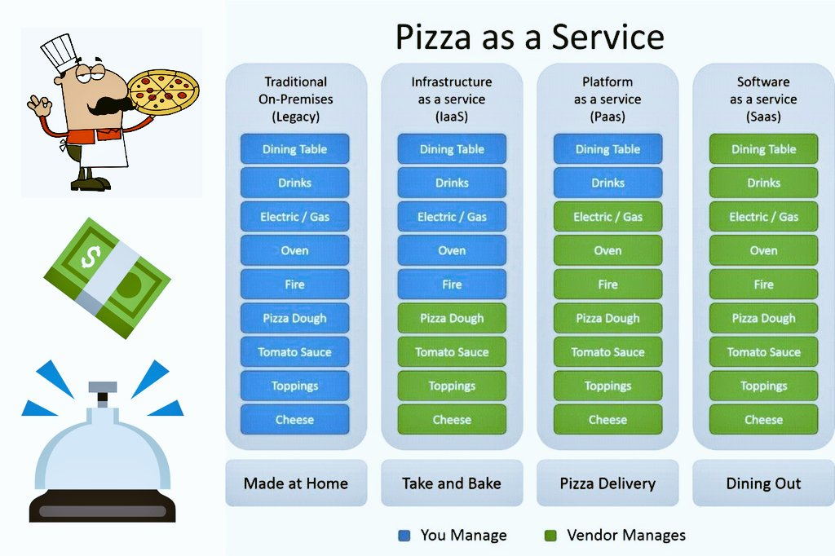

Slide 9
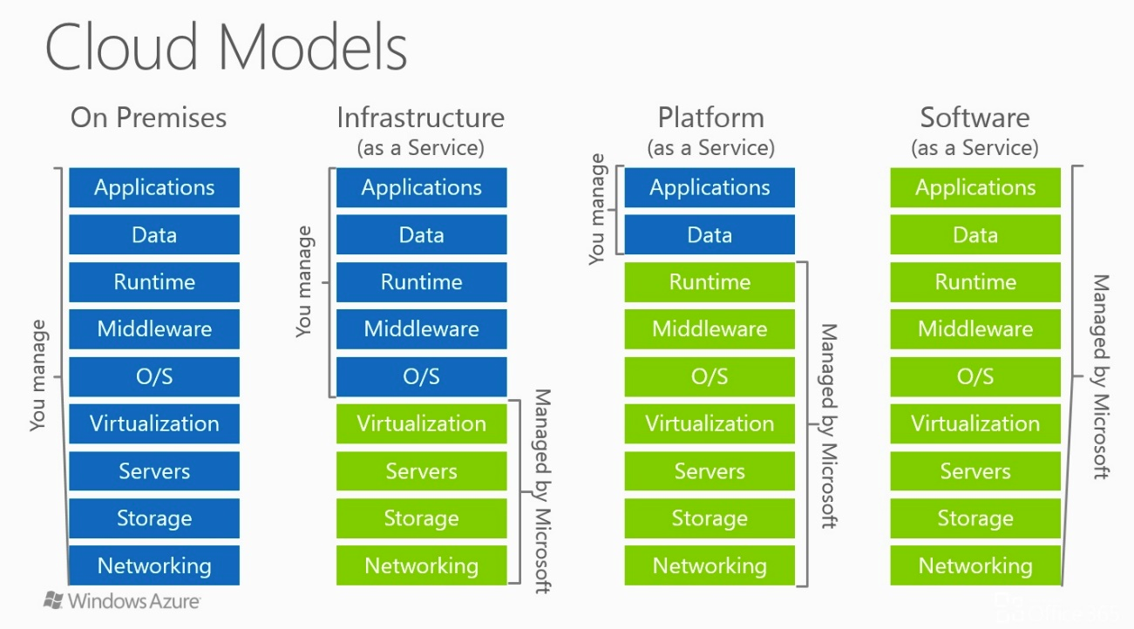

Slide 10
Motivation
Situation 1
Our computational needs are infinite, whereas our financial resources are finite
Users will always want more & more powerful computers
Try & utilize the potentially hundreds of thousands of computers that are interconnected in some unified way need seamless access to remote resources
Situation 2
40%Mainframes are idle
90% Unix servers are idle
95% PC servers are idle
0-15% Mainframes are idle in peak-hour
70% PC servers are idle in peak-hour

Slide 11

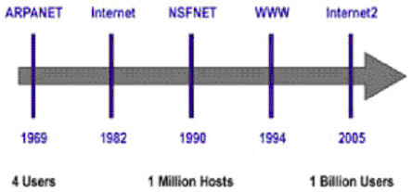
In 1969, Leonard Kleinrock, one of the chief Scientists of the original Advanced Research Projects Agency Network (ARPANET) which seeded the internet said:
“ As of now, computer networks are still in their infancy, but as they grow and become sophisticated, we will probably see the spread of ‘Computer utilities, which like present electric and telephone utilities, will service individual homes and offices across the country,”

Slide 12
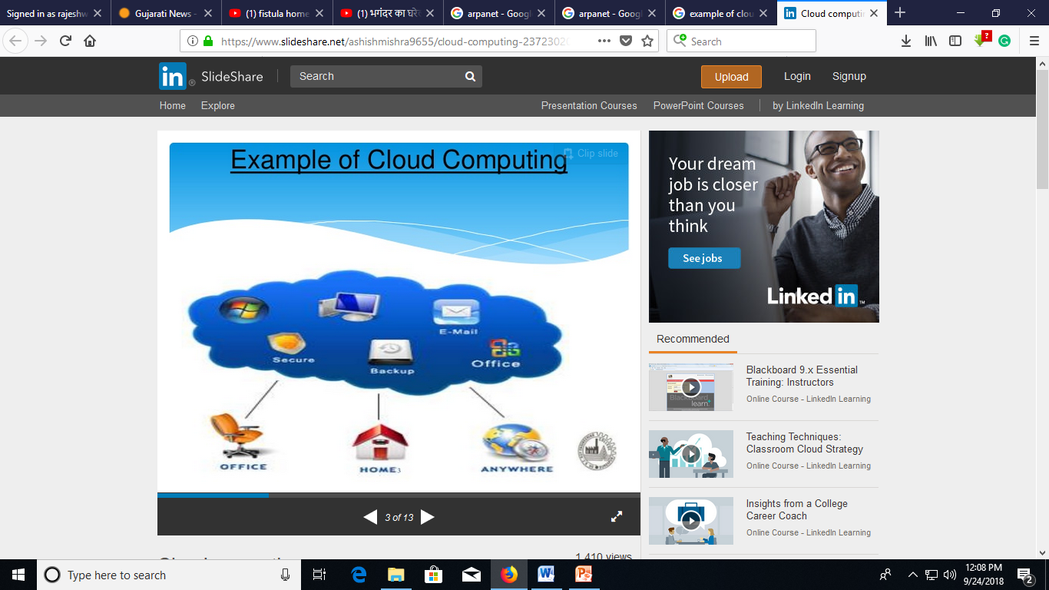
Introduction
Example of Bank.

Slide 13
Introduction
Whenever you travel through a bus or train, you take a ticket for your destination and hold back to your seat till you reach your destination. Likewise other passengers also takes ticket and travel in the same bus with you and it hardly bothers you where they go. When your stop comes you get off the bus thanking the driver. Cloud computing is just like that bus, carrying data and information for different users and allows to use its service with minimal cost.
Cloud Computing provides us means of accessing the applications as utilities over the Internet. It allows us to create, configure, and customize the applications online.
Cloud Computing turns IT services into utilities
It is effective composition of several technologies.

Slide 14
History & Evolution of Cloud Computing
The idea of renting computing services by leveraging large distributed computing facilities has been around for a long time.
From mainframes in the early fifties , technology has evolved and refined.
Five core technologies that played an important role in the realization of cloud computing :
Distributed Systems
Virtualization
Web 2.0
Service Oriented Computing and
Utility Computing

Slide 15
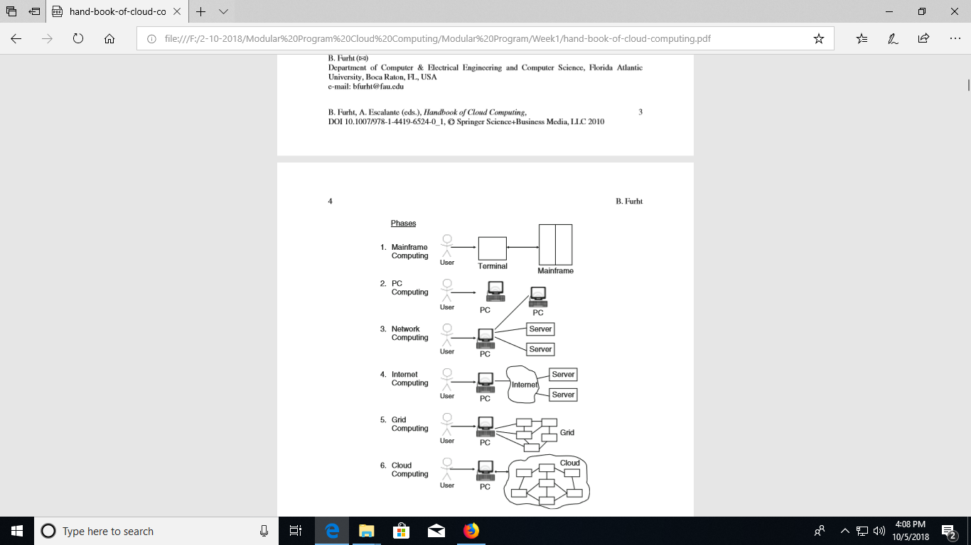

Slide 16
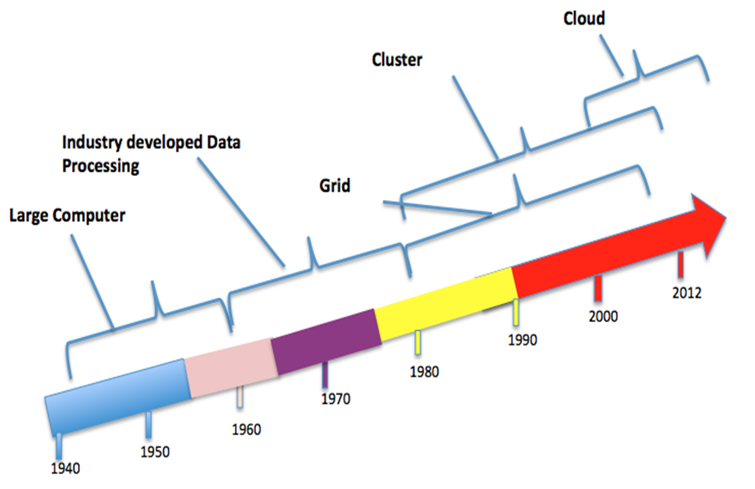

Slide 17
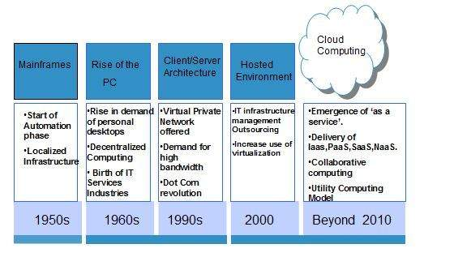
The concept of Cloud Computing came into existence in the year 1950 with implementation of mainframe computers, accessible via thin/static clients. Since then, cloud computing has been evolved from static clients to dynamic ones and from software to services.
Three major milestones have led to Cloud Computing:
Mainframe Computing, Cluster Computing, Grid Computing

Slide 18
Mainframes
Large computational facilities leveraging multiple processing units.
Highly reliable computers specialized for large data movement and massive IO operations
Used by large organizations for their bulk data processing such as online transactions, ERP and other operations involving the processing of significant amount of data
Example: Online banking, airline ticket booking, supermarket and government services…

Slide 19
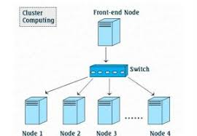
Clusters
A Computer cluster is a group of tightly coupled computers that work together closely so that it can be viewed as a single computer.
Clusters are commonly connected through fast local area networks.
Unlike grid computers, computer clusters have each node set to perform the same task, controlled and scheduled by software.
Clusters have evolved to support applications ranging from e-commerce to high performance database applications.

Slide 20
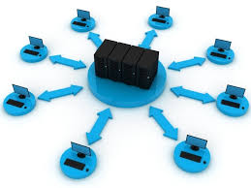
Grid Computing
Grid computing is a distributed architecture of large numbers of computers connected to solve a complex problem. In the grid computing model, servers or personal computers run independent tasks and are loosely linked by the Internet or low-speed networks. Computers may connect directly or via scheduling systems.
Most applications for grid computing projects have no time dependency, and large projects typically deploy across many countries and continents. Search programs and others use the idle power of computers, also known as cycle-scavenging, running in the background for many weeks.

Slide 21
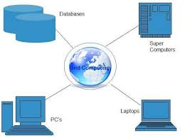
Grids
Grid computing is a processor architecture that combines computer resources from various domains to reach a main objective. In grid computing, the computers on the network can work on a task together, thus functioning as a supercomputer.
Typically, a grid works on various tasks within a network, but it is also capable of working on specialized applications. It is designed to solve problems that are too big for a supercomputer while maintaining the flexibility to process numerous smaller problems. Computing grids deliver a multiuser infrastructure that accommodates the discontinuous demands of large information processing.

Slide 22
Virtualization
The main enabling technology for Cloud Computing is Virtualization.
Virtualization is a partitioning of single physical server into multiple logical servers.
Once the physical server is divided, each logical server behaves like a physical server and can run an operating system and applications independently.
Many popular companies' like VMware and Microsoft provide virtualization services, where instead of using your personal PC for storage and computation, you use their virtual server.
They are fast, cost-effective and less time consuming.

Slide 23
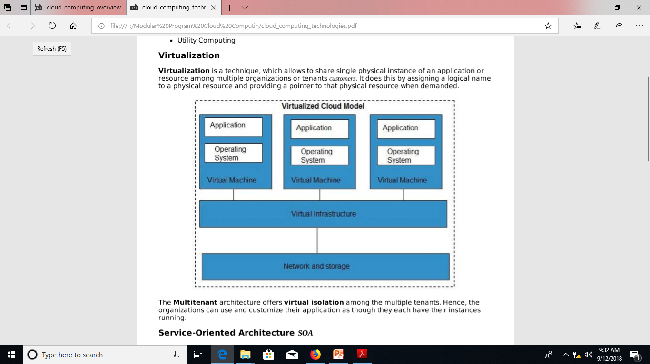
Virtualization
Virtualization is a technique, which allows to share single physical instance of an application or resource among multiple organizations or tenants customers. It does this by assigning a logical name to a physical resource and providing a pointer to that physical resource when demanded.

Slide 24
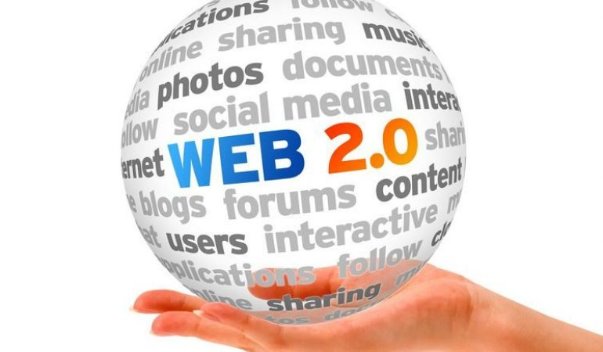
Web 2.0
The second stage of development of the Internet, characterized especially by the change from static web pages to dynamic or user-generated content and the growth of social media.
Web 2.0 is the current state of online technology as it compares to the early days of the Web, characterized by greater user interactivity and collaboration, more pervasive network connectivity and enhanced communication channels.
Web 2.0 is the term used to describe a variety of web sites and applications that allow anyone to create and share online information or material they have created. A key element of the technology is that it allows people to create, share, collaborate & communicate.

Slide 25
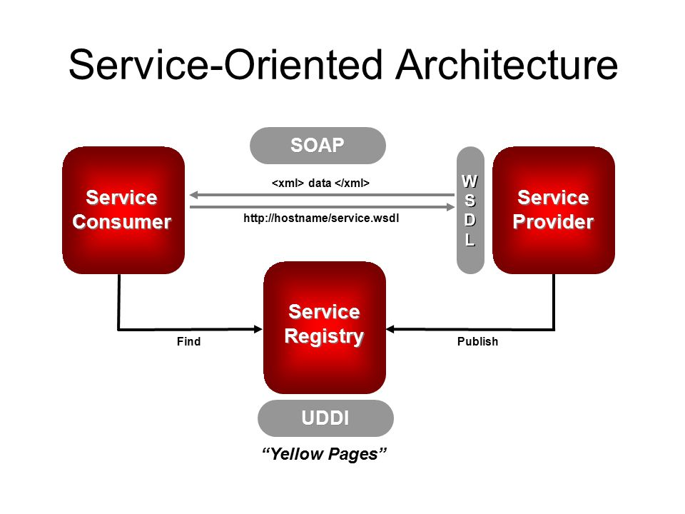
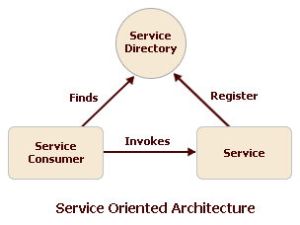
Service-Oriented Computing / Service-Oriented Architecture SOA
Service-Oriented Architecture helps to use applications as a service for other applications regardless the type of vendor, product or technology. Therefore, it is possible to exchange the data between applications of different vendors without additional programming or making changes to services.

Slide 26
Previous Computing Techniques
Distributed Computing
Grid Computing
Utility Computing
Elastic Computing

Slide 27
Utility Computing/Utility-Oriented Computing
Utility computing is based on Pay-per-Use model. It offers computational resources on demand as a metered service. Cloud computing, grid computing, and managed IT services are based on the concept of utility computing.
McCarthy (1961)
“If computers of the kind I have advocated become the computers of the future, then computing may someday be organized as a public utility just as the telephone system. The computer utility cloud become the basis of a new and important industry.. “

Slide 28
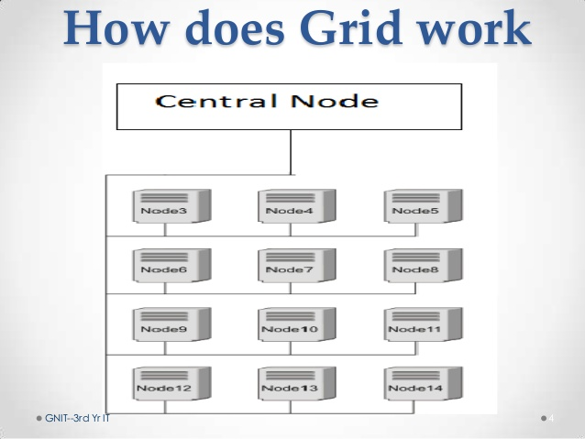
Grid Computing
Grid Computing refers to distributed computing, in which a group of computers from multiple locations are connected with each other to achieve a common objective. These computer resources are heterogeneous and geographically dispersed. Grid Computing breaks complex task into smaller pieces, which are distributed to CPUs that reside within the grid

Slide 29
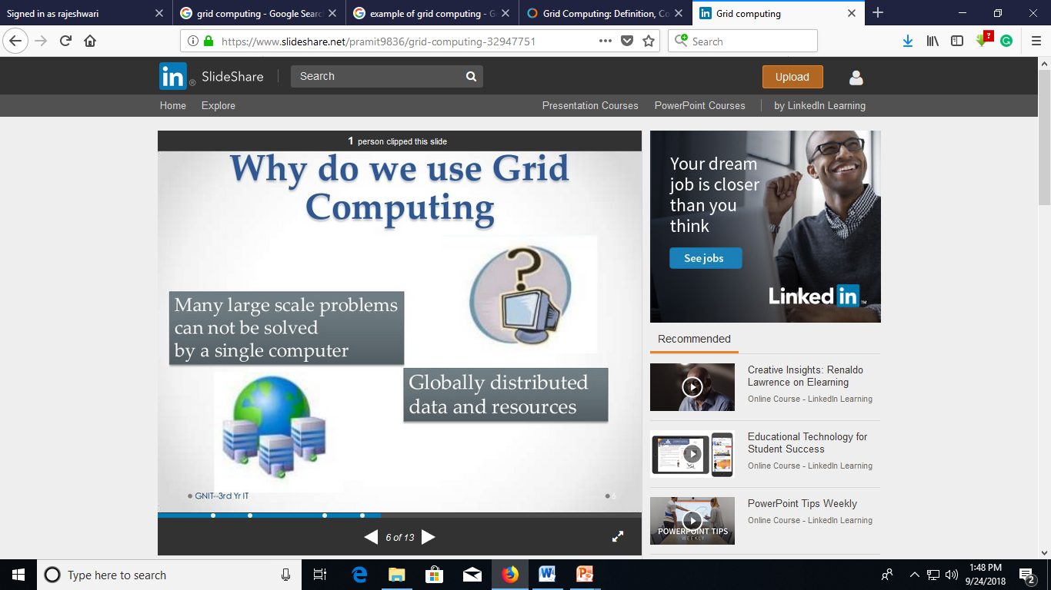

Slide 30
Elastic computing
Elastic computing is a concept in cloud computing in which computing resources can be scaled up and down easily by the cloud service provider. Elastic computing is the ability of a cloud service provider to provision flexible computing power when and wherever required.
In cloud computing, elasticity is defined as "the degree to which a system is able to adapt to workload changes by provisioning and de-provisioning resources in an autonomic manner, such that at each point in time the available resources match the current demand as closely as possible".
Elasticity is a defining characteristic that differentiates cloud computing from previously proposed computing paradigms, such as grid computing. The dynamic adaptation of capacity, e.g., by altering the use of computing resources, to meet a varying workload is called "elastic computing"

Slide 31
Cloud Computing
Is a network based computing that takes place over the internet.
Basically it’s step on from utility computing.
A collection/group of integrated and networked hardware, software and internet infrastructure (Called platform)
Using the internet for communication and transport provides hardware , software and networking services to clients
It is the cloud systems support dynamic provisioning of IT Services whether they are virtual infrastructure, runtime environments or application services and adopts a utility-based cost model to price these services.

Slide 32
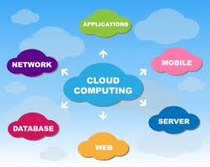
Cloud Computing
Cloud Computing refers to both the applications delivered as services over the internet and the hardware and system software in the data centers that provide those services.
Cloud Computing can be defined as delivering computing power( CPU, RAM, Network Speeds, Storage OS software) a service over a network (usually on the internet) rather than physically having the computing resources at the customer location.
Example: AWS, Azure, Google Cloud
Cloud Computing refers to manipulating, configuring, and accessing the hardware and software resources remotely. It offers online data storage, infrastructure, and application.
Cloud computing offers platform independency, as the software is not required to be installed locally on the PC. Hence, the Cloud Computing is making our business applications mobile and collaborative.

Slide 33
Personal Computing Environment.
Time Sharing Computing Environment.
Client Server Computing Environment.
Distributed Computing Environment.
Grid Computing Environment.
Cluster Computing Environment.

